Slide 1
Developing targeted outreach to subpopulations within the context of a comprehensive sexual violence prevention plan
Anna Sotelo-Peryea Public Health Planner, Violence Prevention Coordinator
Agenda
Brief Overview
Building Faculty Connections
Reaching LGBTQ+ Students
Planning Resources
Q(&A)
Notes:
Description: This session will provide concrete examples of targeted outreach to faculty and LGBTQ students, as they fit within a comprehensive sexual violence prevention plan that has been in practice at SUNY Buffalo since 2007. Resources for planning processes and implementation will be provided, as well as training resources and lessons learned.

Slide 2
DETAILS OF A UNIVERSITY REACHING OTHERS
A flagship institution and the
largest and most comprehensive
campus in the 64-campus
State University of New York
System.
A comprehensive, research-intensive public university
dedicated to academic
Excellence.
PRESIDENT | Satish K. Tripathi
STUDENT BODY | 28,952 (fall 2012) 19,506 undergraduate 9,446 graduate and professional
FACULTY | 2,298 (2013)
ALUMNI | More than 230,000 in 130 countries (2013)
EMPLOYMENT | 6,622 full-time equivalent employees

Slide 3
Building Faculty Connections
Passive
Faculty Guide
Don’t Cancel That Class
Quarterly In-Service Trainings
Proactive
Build relationships
Deans
Dept. Secretaries
Researchers
Custom trainings
Gate crashing
Faculty guide available at www.buffalo.edu/USE

Slide 4
Reaching LGBTQ+ Students
Developing self
Be safe
Be present
Seek specialized training
Use the lens (data, research, examples)
Developing program
Policies & protocols
Educate key partners
Partner with LGBTQ+ student groups, community groups
Weave throughout your work
Notes:
Get safezone trained – if your college doesn’t have a safezone program, reach out to a neighboring school
Attend public events (ex: Pride, Lavender Reception), *ask if ok* to attend a club or student association meeting
Examples, recruitment, healthy relationship image representation, normalizing inclusions.

Slide 5
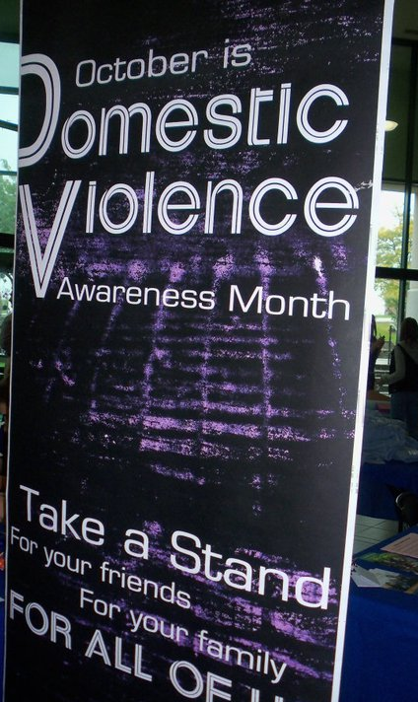
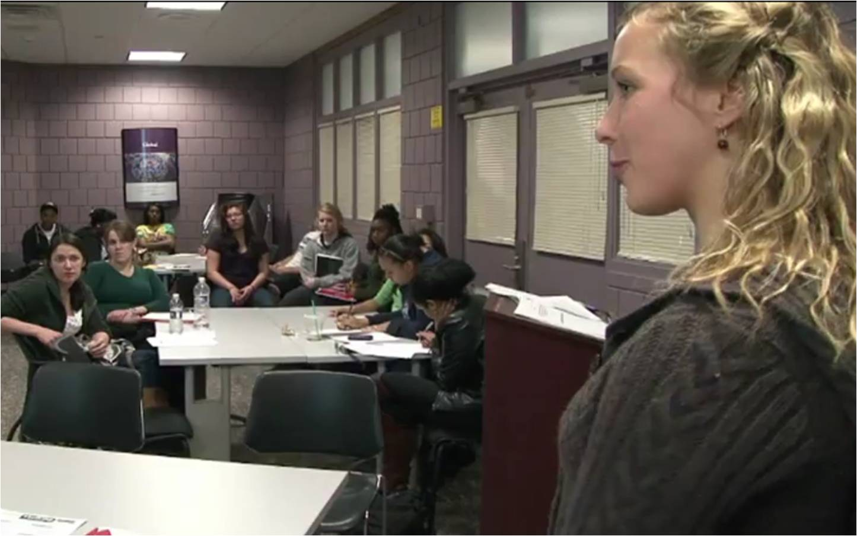
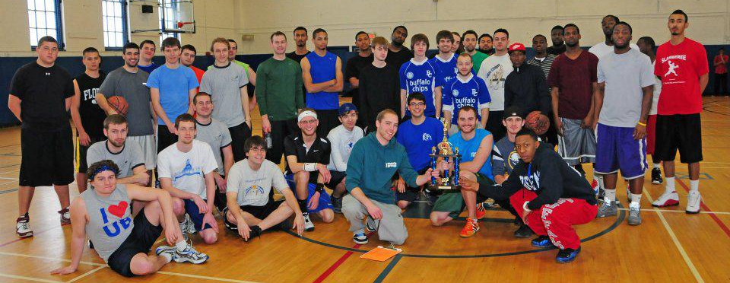
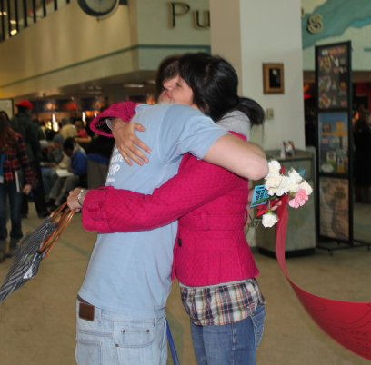
How do we do the work?
Prevention
Risk Reduction
Awareness/Outreach
Notes:
Prevention – Bystander Intervention, HAVEN, Universal Screening for SV, Peer Education Program, How to Help
Risk Reduction – Alcohol Harm Reduction Education, Safety Services
Awareness/Outreach –Walk A Mile In Her Shoes, Love & Support Day

Slide 6
Don’t..
Make assumptions about someone’s gender identity, or sexuality
Out someone’s sexual orientation or transgender status
Get hung up on being ‘the expert’ or ‘right’
Do..
Use inclusive &/or reflective language
Talk to the person before advocating on their behalf
Get comfortable with how much you don’t know/ being uncomfortable
Notes:
Use gender neutral language and inclusive language to open the door to all survivors.
Inclusive language:
• Use the term “partner” or “significant other” instead of “boyfriend/girlfriend”, or “husband/wife”
• Ask “are you seeing someone?” or “are you in a committed relationship?” instead of “do you have a girlfriend/boyfriend?” or “are you married?”

Slide 7
Resource: Forge Forward http://forge-forward.org
VAWA Non-Discrimination Conditions
Serving Transgender and Gender Non-Conforming SA Victims
Stalking Basics and Transgender Individuals
Forensic Exams with Transgender SA Survivors
Trans Specific Barriers to Accessing Health Care
Transgender People, IPV and the Legal System
Transgender 101 for Victim Service Providers
Notes:
Important updates, as well as trainings - All free and available as on-demand webinars

Slide 8
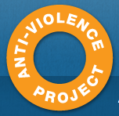
Resource: The Anti-Violence Project www.avp.org
The NCAVP Training and Technical Assistance
Toll-free warmline: 1-855-AVP-LGBT
Mon-Fri, 10 a.m. to 6 p.m. EST Deaf accessible instant messaging AIM: AVPlgbt
Downloads:
Brochures
Glossary of terms, vocab quiz
LGBTQ-inclusive model policies
Notes:
The New York City Anti-Violence Project empowers lesbian, gay, bisexual, transgender, queer, and HIV-affected communities and allies to end all forms of violence through organizing and education, and supports survivors through counseling and advocacy.
Center is available for direct service and advocacy organizations seeking answers, support, and strategies to become inclusive of and accessible to lesbian, gay, bisexual, transgender, and queer (LGBTQ) survivors. NCAVP members are available to provide technical assistance on issues such as language and terminology, creating an LGBTQ-inclusive organization, developing LGBTQ-inclusive policies and procedures, building relationships with LGBTQ communities and more. All questions and requests for assistance are welcome.

Slide 9
Resource: The Network/la Red http://tnlr.org
Free technical assistance 617-695-0877
Free help with program policies and procedures, consultation on steps to make your program more LGBQ/T-inclusive
Web resources:
Bisexual Specific Partner Abuse Brochures
Assessment: How inclusive is your agency?
Survivor experiences column (ex: Community responses to partner abuse)
Notes:
The New York City Anti-Violence Project empowers lesbian, gay, bisexual, transgender, queer, and HIV-affected communities and allies to end all forms of violence through organizing and education, and supports survivors through counseling and advocacy.
Center is available for direct service and advocacy organizations seeking answers, support, and strategies to become inclusive of and accessible to lesbian, gay, bisexual, transgender, and queer (LGBTQ) survivors. NCAVP members are available to provide technical assistance on issues such as language and terminology, creating an LGBTQ-inclusive organization, developing LGBTQ-inclusive policies and procedures, building relationships with LGBTQ communities and more. All questions and requests for assistance are welcome.

Slide 10
Planning Resources
ACHA Healthy Campus Initiative
http://www.acha.org/healthycampus/
Shifting the Paradigm: Primary Prevention of Sexual Violence Toolkithttp://www.acha.org/sexualviolence/
Workbook, logic models

Slide 11
Ask yourself if what you are doing today is getting you closer to where you want to be tomorrow.
Questions?
acperyea@buffalo.edu

