Slide 2
Student Centered & Sustainable Methods for Education on Sexual Assault
Paula Madrigal, MSW
Jason Parker, M.A.

Slide 3
Introduction
Paula A. Madrigal, MSW
Wellness & Prevention Coordinator
Weigel Health Promotions
madrigpa@buffalostate.edu
716-878-4719
Jason Parker, M.A.
Diversity Program
Coordinator
Equity & Campus Diversity
parkerjo@buffalostate.edu
716-878-6210
Recently featured in:
NPR This American Life
Episode 557: “Birds & Bees”
Fusion – ABC News Affiliate
“Lets stop comparing sex to baseball”

Slide 4
Group Discussion
What do you do for sexual assault education?
What challenges do you have? (ex staff, $, time etc.)
What area(s) of sexual assault are currently considered “urgent” by your campus?
(ex training, staff, alcohol, Greeks, athletes, consent etc.)
What do you want to learn/know/accomplish from this session?

Slide 5
Buffalo State Case Study: Challenges & Need
DOJ Grant Expired
Change in staff, responsibilities, delivery of services
Little to no resources/funds
Many people doing similar work – duplicating services
Notes:
VIVA Grant – Expired
Coordinator – not renewed
Assistant Director – Resigned
New Health Educator – Programs (advocacy to counseling)
New Staff in Equity & Campus Diversity
Lots of change in staff and delivery
Little to no resources/funds

Slide 6
Buffalo State Case Study: Collaboration
Collaboration
Holistic Approach
Wellness & Prevention
(workshops, orientation, peer educators)
Dean of Students/Judicial
(orientation/hearings)
Counseling Center
(counseling, workshops, orientation)
Equity & Campus Diversity
(I Love Consent, Ambassadors, Speakers/Film)
UPD
USG
Communications Dept
Safety Committee
Notes:
Many people doing work → MOU

Slide 7
Buffalo State Case Study: MOU
Collaboration
Wellness & Prevention
Dean of Students/Judicial
Counseling Center
Equity & Campus Diversity
UPD
Notes:
MOU Document – written agreement on how we will collaborate

Slide 8
Buffalo State Case Study: Strengths
New and engaged staff & students (including administration)
Graduate Intern
Peer Educators
Ambassadors
Orientation – Acting Out
Take Back The Night – Performance Based (300-500 attendees annually)
My Masculinity Helps – VAWA DVD (NCCASA)
Established relationships & Collaboration (& crisis svcs; Horizon Health Services (opiate & therapy dogs); WNY group)
Equity & Campus Diversity: Created I LOVE Consent & MOU
Communications Department
SHATTERED – Devised Theatre (Anne Frank Project)
Sanctioned Student Program
Do Your Part: Bystander Intervention Program

Slide 9
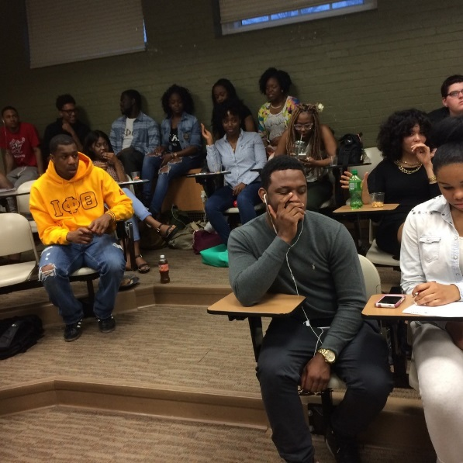
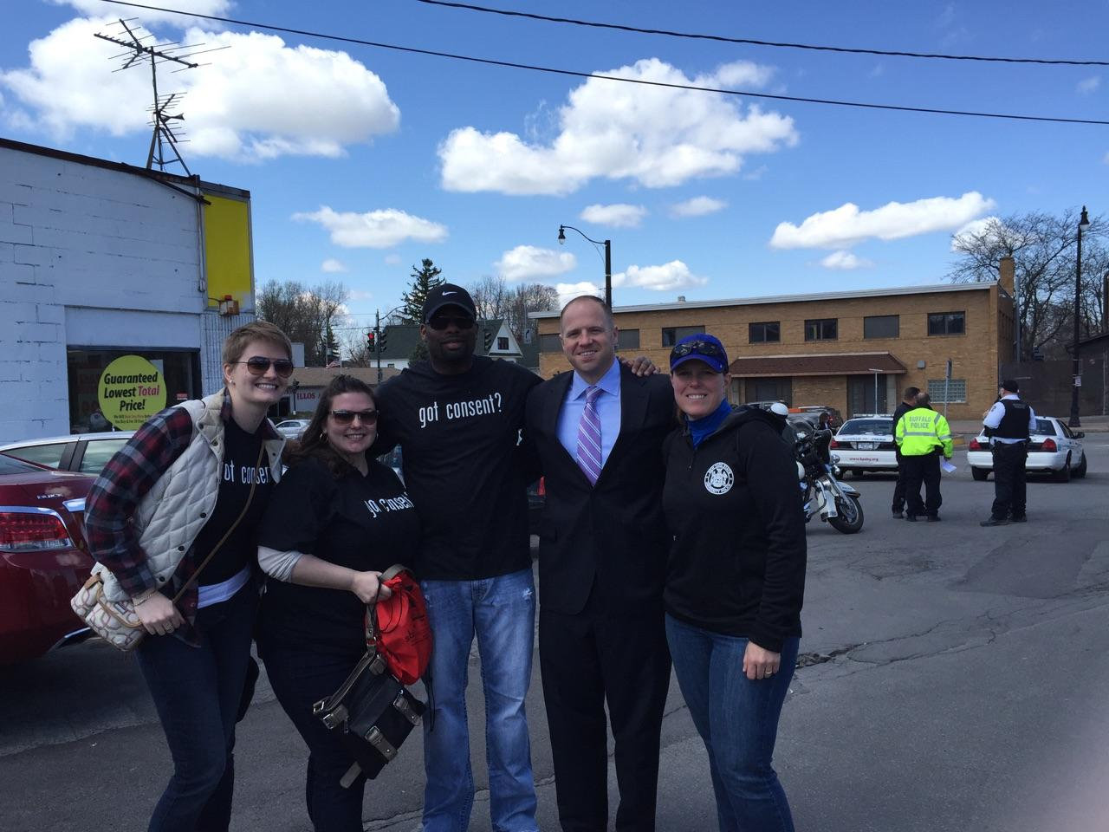
Buffalo State Case Study: Strengths – I Love Consent
I LOVE Consent
Created by students for students
Featured on NPR – May 2015
Walk A Mile In Her Shoes with Crisis Services
Notes:
Jason to discuss I Love Consent program and roots

Slide 10
Buffalo State Case Study: Implementation
Notes:
Webpage – student experience
Photo shoot & student poetry
The Front TV show – student experience

Slide 11
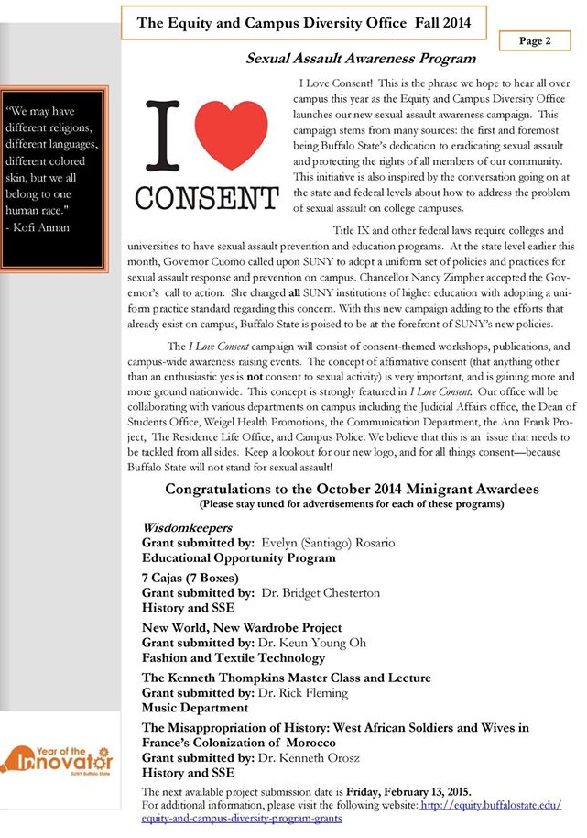
Buffalo State Case Study: Implementation
Jason
Graduate Intern Developed: I <3 Consent
Campaign Kickoff, Train The Trainer
Paula
Videos/YouTube
Webpage
Market & Promote
Sanctioned Students
Interns, Peer Educators
MOU
Notes:
Implementation - collaboration

Slide 12
Buffalo State Case Study: Strengths – Sanctioned Students
Captive audience
View & Review Videos
Attend, promote & evaluate events
Social Media
Follow
Engage

Slide 13
Buffalo State Case Study: Strengths – Sanctioned Students
Event Evaluation Form
Name of the event
SHATTERED
Speaker(s)
Workshop
Training
Other
Who facilitated it
How did you hear about it?
Where & when was it?
Rate it on a scale of 1-5
Attach photos, programs etc.
Notes:
Feedback – how are they hearing about events? What motivates them to attend? Who do they bring with them? etc.

Slide 14
Buffalo State Case Study: PSA Videos: Communication Collaboration
Jason asked communications to collaborate on
film series
Paula asked communications for video interns
Class was creating “PSA” videos for “clients”
Educated class on Bystander Intervention
Do Your Part PSA → Generic Topics (1st Class)
Educated class on Sexual Assault
Do Your Part PSA → Sexual Assault (2nd Class)
Notes:
PSA Video Collaboration with Communications
1 year (2 semesters; 2 professors; 4 classes; 12+ DYP PSA videos)
Education to the class (DYP) then further education to the sub groups on individual topics from the Wellness & Prevention Coordinator
Students then create the scripts, the message and the videos (grassroots)

Slide 15
Buffalo State Case Study: PSA Videos: Communication Collaboration
NEW: Buffalo State Supports Survivors (communications class)
Survivor Story - I Love Consent – Do Your Part (communications)
What to do if you are sexually assaulted? (communications)
Consent Program Kickoff Video (health promotions peer educators recorded)
I Love Consent: Sexual Assault Awareness Playlist and PSAs (health promotions peer educators recorded)
Take Back The Night Montage Videos (misc. communications or TFA students record)

Slide 16
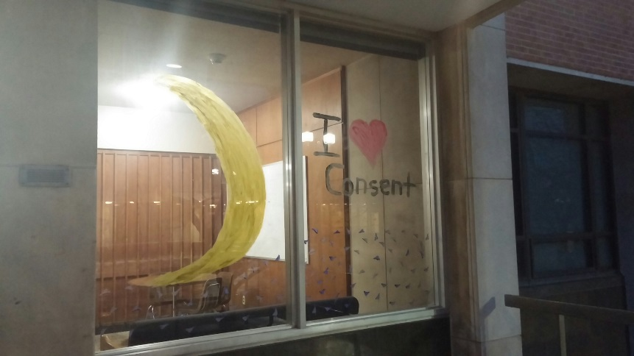
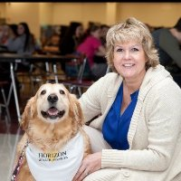
Buffalo State Case Study: PSA Videos: How to utilize them
Residence Life Window Painting Contest: Sexual Assault & Take Back The Night Awareness
Trainings
Peer Educators
Paraprofessional Staff
Workshops
I LOVE Consent
Don’t Cancel That Class
Social Media
Promotion
(TBTN; SHATTARED; Therapy Dogs; AOD; Misc Events)
Sanctioned Students
Data/Assessment
(views, likes, comments, subscriptions etc.)
Therapy Dog Workshops
Break Down Barriers & Open Dialogue with Difficult Conversations
Notes:
Discuss how we utilize videos
Sanctioned Students; View and critique videos for community service (handout with comments from students)
Peer Educators; Workshops; Trainings; Don’t Cancel That Class; Social Media; Assessment (YouTube Views, likes, comments, subscriptions, etc.)
Therapy Dog information: http://well.blogs.nytimes.com/2015/05/27/anxious-students-strain-college-mental-health-centers/?smid=fb-share&_r=0

Slide 17
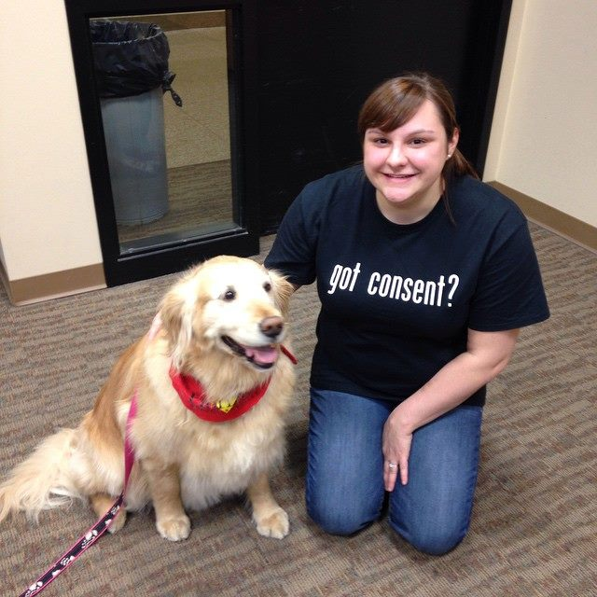
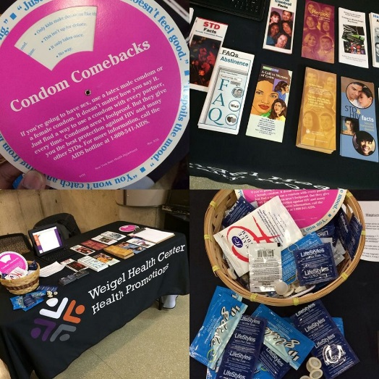
Buffalo State Case Study: PSA Videos: Promote Events & Information
Therapy Dog Workshops
Break Down Barriers & Open Dialogue with Difficult Conversations
Buffalo State Record: School Newspaper Online
Links to Videos, Webpage, Information & Events
Notes:
It is important to stay current. Ex. School newspaper is online also and links to our webpage, videos etc.

Slide 18
Buffalo State Case Study: PSA Videos: YouTube Data & Hits
Notes:
Our YouTube Channel
Playlist
We also use other videos (you can link to them; ex. White house, VAWA, other schools)

Slide 19
Buffalo State Case Study: PSA Videos: YouTube Data & Hits
Views & Likes
300+ Views in less than 4 months
Published
Student Interaction and Comments
Notes:
Discuss how we utilize videos
Sanctioned Students; View and critique videos for community service (handout with comments from students)
Peer Educators; Workshops; Trainings; Don’t Cancel That Class; Social Media; Assessment (YouTube Views, likes, comments, subscriptions, etc.)

Slide 20
Buffalo State Case Study: PSA Videos: YouTube Data & Hits
Notes:
Views
Estimated Minutes Watched
Average View Duration
*Measure this during the semester – not when there is no school

Slide 21
Buffalo State Case Study: PSA Videos: YouTube Data & Hits
Notes:
Views within a period of time
Gender
Location
Traffic (where is it coming from?)

Slide 22
Buffalo State Case Study: PSA Videos: Strengths
Sustainable
Little to no cost (school provides equipment to rent)
Created by students – what they think are the most important issues to immediately capture
Grass roots/holistic and inexpensive – includes bystander intervention message
Unique to the campus/culture
Can be shared/used among similar campuses/groups
Notes:
Discuss

Slide 23
Buffalo State Case Study: PSA Videos: Student Feedback
“I really enjoyed watching the youtube videos. One of the first videos that I seen was the take back the night. I really liked the performances that I seen in the video. I really wished that I went to the event. Another video that I watched is the I love consent video. I think the sexual consent is a huge problem and needs to be addressed. The I love consent video only had 310 views, I think you should promote the youtube page more. Make it mandatory to watch these videos so students are aware. Another one I watched was the sexual assault.I did not know that this happens so often, i did not know that 60% is not reported. Just like the consent video I think it should have more videos.”
Notes:
Comments from sanctioned students who attended or viewed the sexual assault videos
These are examples of grassroots/holistic efforts that are sustainable, from the students perspective and understood.
It doesn’t matter how “smart” or “pretty” important issues look on paper – what matters is if the students have access, engage and understand.

Slide 24
Buffalo State Case Study: PSA Videos: Student Feedback
“This video has directly impacted the way I see college. To this point, I have struggled with my GPA, and started to get into trouble. Dropping out crosses my mind multiple times every day. To me, this is by far the most important video that could be shown to incoming Freshmen. We don't want to hear professors talk about what not to do. We don't want to talk to our parents about it either because parents can be harsh sometimes on the subject of school. What we want to see is students who were previously in our position and made it out..” Thanks to this video, I will be seeking help and becoming more involved in on-campus groups that will help me see college in a different, more pleasant light.”
Notes:
Comments from sanctioned students who attended or viewed the sexual assault videos

Slide 25
Buffalo State Case Study: PSA Videos: Student Feedback
“Watched a movie on masculinity and sexual assualt. It was a good film and really gets the point across that speaking up about something sexist etc. wont make you less of a man”
“I really enjoyed going to the workshops. The Anne Frank project presentations were very enjoyable. The videos i watched on the youtube channel(Sexual Assault PSA,I Heart Consent, Stress and Rentention PSA,Do your part PSA,) were very good yet i felt were a little short i wish they had been slightly longer. And i wish there were more videos posted up on a more weekly basics. The facebook page was very informative with daily post but wish you could post more”

Slide 26
Buffalo State Case Study: Event Evaluation: Student Feedback
FEMALE STUDENT #3 Name of the Event, Training, Workshop * | Consent
Who facilitated it? * | Paula Madrigal
How did you hear about it? * | Paula
When was it? * | Wednesday, March 18, 2015
Photos, flyers, programs or paperwork from the event.
I enjoyed attending this event/activity | Strongly Agree
Thoughts, comments and/or suggestions about the activity completed * | I thought the workshop was quite entertaining. It was interesting to hear the different points of view that people have on getting consent. It's also important to know these kind of things in respect for yourself as well as your partner. More people should be aware that consent is something important. The snacks were really good as well! :)
Notes:
Comments from sanctioned students who attended or viewed the program
FEMALE STUDENT #3
Name of the Event, Training, Workshop *
Consent
Who facilitated it? *
Paula Madrigal
How did you hear about it? *
Paula
When was it? *
Wednesday, March 18, 2015
Photos, flyers, programs or paperwork from the event.
I enjoyed attending this event/activity
Strongly Agree
Thoughts, comments and/or suggestions about the activity completed *
I thought the workshop was quite entertaining. It was interesting to hear the different points of view that people have on getting consent. It's also important to know these kind of things in respect for yourself as well as your partner. More people should be aware that consent is something important. The snacks were really good as well! :)

Slide 27
Buffalo State Case Study: Final Thoughts/Papers: Student Feedback
“I feel like the “I heart consent” campaign was a nice program to sit through because I got to learn a lot of statistics about rape and consent that I had not known. I learned that about 90% of college rape cases happened in the first four semesters of a woman’s college career. I learned that as far as consent “yes means yes”
Notes:
Sanctioned student papers

Slide 28
Buffalo State Case Study: Final Thoughts/Papers: Student Feedback
“The event I enjoyed the most was the “I heart consent” I believe this was one of the best events on campus. There are many issues about sexual consent and rape all over the world and especially on college campus. One in four women with get sexually assault once in their life and 25% is just way too much. People need to learn about consent and how to give consent or receive consent when going to perform in sexual activities. People think just giving signs is actually consent, but it really isn’t. Until the partner they you are going to perform sexual activities with physically says YES then until then she probably didn’t give consent. And people shouldn’t risk getting themselves in trouble over something like that. Something so simple like a yes or a no answer can get a person on campus in serious trouble with the school and in bigger trouble with the law and police and I know nobody does not want to get in trouble with the police on campus. Overall my whole community service experience was actually a good one. I enjoyed doing all the things I did for the community service. Whether it was making flyer for Paula to advertise an event on campus and passing them out.”
Notes:
Sanctioned student papers

Slide 29
Buffalo State Case Study: Final Thoughts/Papers: Student Feedback
“The workshop that I participated in was “I <3 Consent.” In this workshop I learned so much about consent, especially when someone have every right to change his/her mind even if he/she said “yes” in the beginning. They have every right to say no afterwards if they are not comfortable or do not want to have any sexual activities. Honestly, I wish I knew this sooner. When I learned about this information, I thought about how I was in a coerced relationship in which my ex-boyfriend didn’t respect me or take me into consideration. I learned that your body can give the wrong message to your partner and they can take your body’s answer instead of your voice. I didn’t know this either but I am glad that I am more aware of it. When I went to this event, I learned all these stuffs that I didn’t know. I wish I was more aware it so that I could have prevent this from happening.”
Notes:
Sanctioned student papers

Slide 30
Buffalo State Case Study: Final Thoughts/Papers: Student Feedback
“I think this is a great workshop who should be spread around more because there are some women, like myself who aren’t fully aware of what consent is. Or that they definitely have a voice or what their partner can or can’t do. Also that it is okay if they change their answer and their partner must respect their decisions at all times.”
Notes:
Sanctioned student papers

Slide 31
Buffalo State Case Study: Final Thoughts/Papers: Student Feedback
“I participated in the I love Consent Workshop which was basically about preventing sexual harassment by teaching individuals that No means No. It was really informative. I also attended lectures given by students who went to Rwanda, which is a country in the continent of Africa that no more than twenty-one years ago was a product of genocide. These events i attended i have to say was an eye opener. I also attended the workshop the NIA Mentor program had on campus, which was to write letters to Ferguson High School students, giving those words of inspiration and motivation. This program is by far my favorite because i got to meet so many new people as well as motivate these young’s students, despite everything occurring in their hometown, helping them find hope. I loved it so much i am actually applying to be a part of the program so it was a great opportunity that i wouldn't have been a part of if i had not been a part of Paula’s Community Service Program. I would not have changed anything, i am glad i had to do community service but most of all glad i had the opportunity to complete my hours with Paula. This programs allows you to complete your hours by going out on campus and just getting involved and it works out perfectly because at the end of the day you find things that interest you and that you want to be a part of. I have to say this experience has helped me be more social and just get a little out my shell more. I was able to attend all these different events and get involve, and go to these events and be social and most of all get to know different people that i would have never encountered otherwise.”
Notes:
Sanctioned student papers

Slide 32
Buffalo State Case Study: PSA Videos: Challenges
Time
Script Writing
Review & Approve
Attention to details
If information/data/statistics change
Notes:
Discuss Challenges (time, logos, approval, attention to detail, if information/data changes)
Email from Ruth: “I think the biggest challenge for my students has been having time to develop their ideas and getting up to speed on difficult topics. I think working with a PR class to work on the development stage and then bringing it to the production class should work better. My students are not trained in creating PSAs or campaigns so I think the videos could be a lot stronger by bringing in another class to work with, at least to do the research and the basic script. I know most of the students find the process rewarding and especially love getting feedback and hearing about their videos getting out there. I think setting the bar high in terms of production values is important and something that is often overlooked with student videos. And Rick and I are cramming this into half of a semester in an Intermediate class. I think it might be better suited for an Advanced class. “

Slide 33
Buffalo State Case Study: PSA Videos: Future Thoughts
Include additional departments
Script writing
Marketing classes
Assessment classes
Study data
Continue building video “library”
Notes:
Future thoughts
Collaborate with additional departments (ex. Script writing, theatre, marketing, assessment, studies, HESA)
Continue building video database (different students connect with different messages)

Slide 34
Buffalo State Case Study: PSA Videos: Theatre
Create a “teaser” video to promote and encourage students to attend
Multiple methods of providing information to students – by students
New students to provide the same or new pieces
Travel, engage and raise awareness (on/off campus)
Collaborate with faculty/staff for extra credit etc.
Some students won’t go – will leave early
Notes:
Theatre Department Production “SHATTARED”
New collaboration with Theatre/AFP
Identify strengths/weaknesses/future considerations

Slide 35
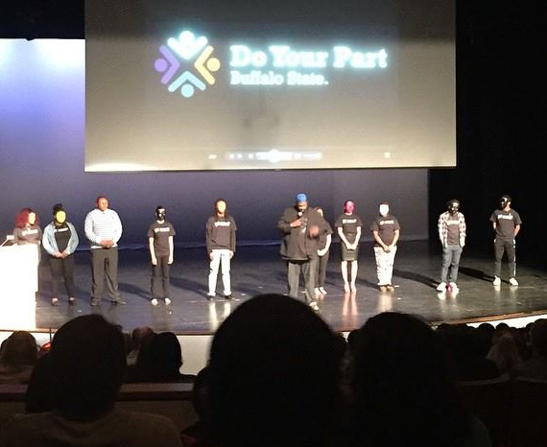
Group Work/Discussion
Question from the beginning:
What area(s) of sexual assault are currently considered “urgent” by your campus?
(ex training, staff, alcohol, Greeks, athletes, consent etc.)
This could be your new PSA!
Notes:
Group work/discussion: Attendees will be asked to identify and share a topic within sexual assault that a 2-3min Public Service Announcement (PSA) Video should be created. (The multiple answers will reflect that the subject matter includes multiple issues that can be examined closely and each video may provide a different perspective or creative method.

Slide 36
Conclusion * Questions
Paula A. Madrigal, MSW
Wellness & Prevention Coordinator
Weigel Health Promotions
madrigpa@buffalostate.edu
716-878-4719
Jason Parker, M.A.
Diversity Program
Coordinator
Equity & Campus Diversity
parkerjo@buffalostate.edu
716-878-6210
Notes:
what matters is if the students have access, engage and understand.

