Slide 1
“Pros and Cons of Distance Learning-the Faculty Perspective”
WNY Consortium of Higher Education Academic Leadership Institute 2017-2018 Group Presentation by:
Dr. Laura Shopp, Bryant & Stratton College
Dr. Hella Jacob, Daemen College
Amy Churchfield, Genesse Community College
Kelli Asklar, Niagara University
Heather Thompson, Trocaire College

Slide 2
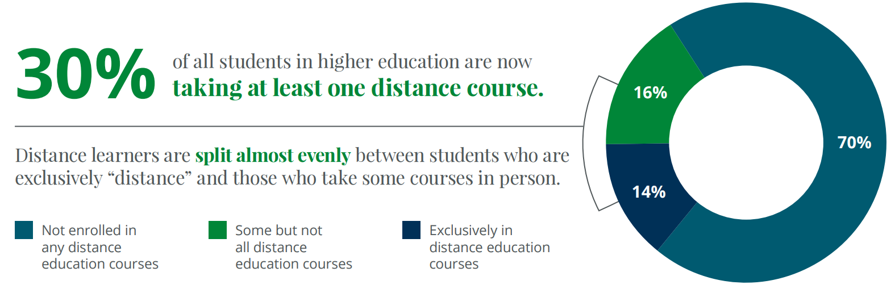
Proportion of Students taking Distance Education Courses
Peaerson Distance Education Enrollment Report 2017

Slide 3
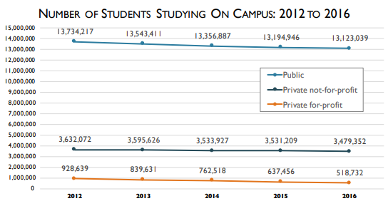
Decline in the Number of On-Campus Students
Grade Increase: Tracking Distance Education in the United States (Babson Survey Research Group), 2018

Slide 4
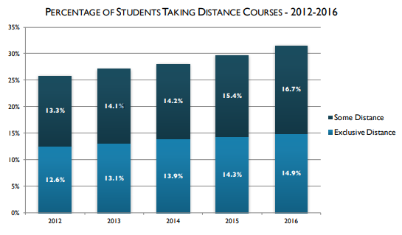
Distance Education Enrollment is Increasing
Grade Increase: Tracking Distance Education in the United States (Babson Survey Research Group), 2018

Slide 5
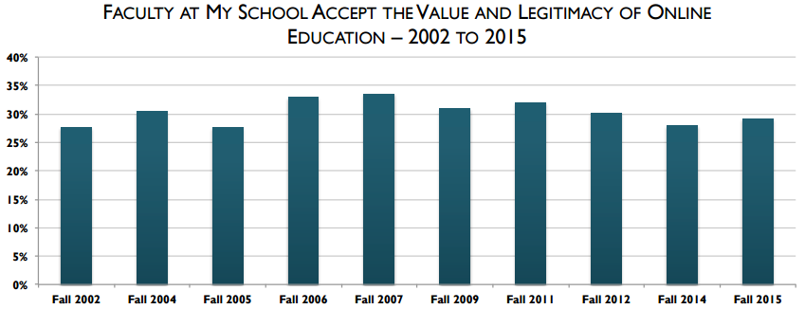
Lack of Progress in Faculty Acceptance of Online Education
Babson Group report, 2016

Slide 6
Faculty Training
Success in the Online Environment

Slide 7
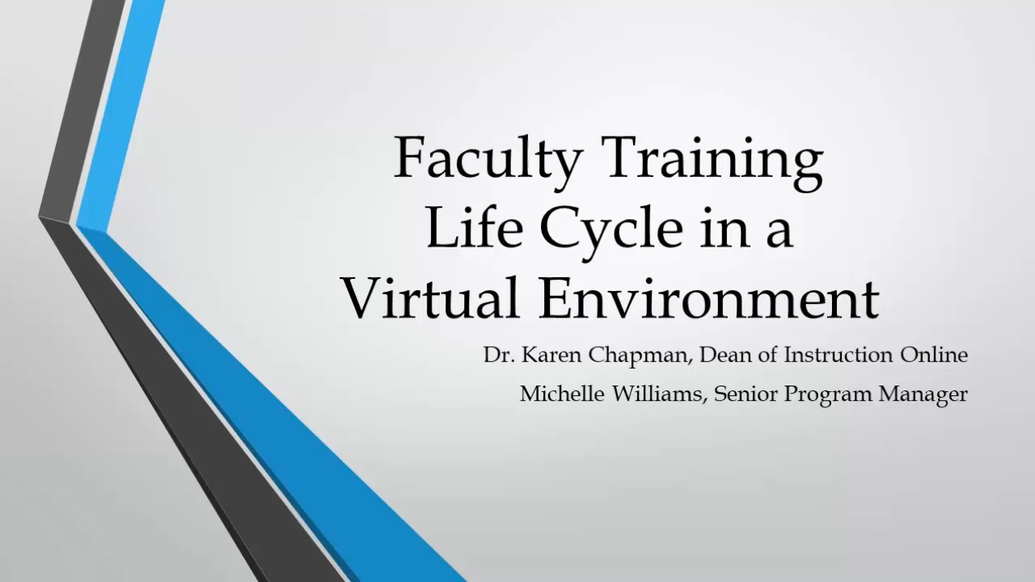

Slide 8
Instructor Training Workshop-Part of New Faculty Orientation
Occurs prior to teaching the first class
Self paced modules that focus on policies, procedures, and best practices in distance education. Cumulative assessment required after completion of 9 modules
Topics include:
  Learning Management System set-up and navigation
  Beginning of term requirements (required documents and preparation for the start of a course)
  Best practices for online discussions
  Grading expectations and rubrics
  Retention center for at risk students

Slide 9
Mentoring Program
New instructors are assigned a mentor. The mentor will coach and guide the new faculty each week. The mentor provides weekly feedback identifying areas of strength and opportunities for improvement.

Slide 10
Onboarding Training Workshops
Workshops with the aim of applying the teaching tenants of the College to the virtual classroom.
  Rubrics, Bloom’s Taxonomy, 7 Principles of Good Practice, COI, and Rigor
Workshops take approximately one year to complete

Slide 11
Ongoing Faculty Training
Mandatory
Asynchronous
Six meetings per year
Discuss best practices in Online teaching which includes instructional delivery, assessment measures, and effective feedback

Slide 12
References-
Allen, E. & Seaman, J. (2017) Digital Learning Compass: Distance Education Enrollment Report 2017. Babson Survey Research Group, e-Literate, and WCET. Retrieved from http://onlinelearningsurvey.com/reports/digtiallearningcompassenrollment2017info.pdf
Appana, S. (2008). A Review of Benefits and Limitations of Online Learning in the Context of the Student, the Instructor and the Tenured Faculty. International Journal on E-Learning, 7(1), 5-22. Waynesville, NC USA: Association for the Advancement of Computing in Education (AACE). Retrieved from https://www.learntechlib.org/p/22909/.
Eagan, M. K., Stolzenberg, E. B., Berdan Lozano, J., Aragon, M. C., Suchard, M. R. & Hurtado, S. (2014). Undergraduate teaching faculty: The 2013–2014 HERI Faculty Survey. Los Angeles: Higher Education Research Institute, UCLA.
Joo, J., Marcum, D. & Rossman, D. (2017). CIC Consortium for Online Humanities Instruction II: Evaluation Report for First Course Iteration. Ithaka S+R. DOI: https://doi.org/10.18665/sr.304859. Retrieved from http://www.sr.ithaka.org/wp-content/uploads/2017/09/SR_Report_CIC_Consortium_II_09192017.pdf
Kessler, G. (2016). What Can We Learn from Our Colleagues? A Framework for Virtual Classroom Training. Online Learning Consortium, Research Center for Digital Learning & Leadership. Report available at: https://onlinelearningconsortium.org/read/olc-research-virtual-classroom-training-survey/
Kessler, G. (2016). 2016 State of the Union: Virtual Classroom Training. Online Learning Consortium. Source: A virtual classroom training survey conducted under the auspices of the University of Virginia IRB. Retrieved from http://info2.onlinelearningconsortium.org/rs/897-CSM-305/images/Virtual_Classroom_Training_Infographic_2016.pdf
Lederman, D. and McKenzie, L. (2017). Faculty Buy-In Builds, Bit by Bit: A Survey of Faculty Attitudes on Technology. Inside Higher Ed. Retrieved from https://www.insidehighered.com/news/survey/faculty-buy-builds-bit-bit-survey-faculty-attitudes-technology
Lieberman, M. (2018). Overcoming Faculty Resistance -- or Not. Inside Higher Ed. Retrieved from https://www.insidehighered.com/digital-learning/article/2018/03/14/experts-offer-advice-convincing-faculty-members-teach-online-or
Meyer, K. (2012). The Influence of Online Teaching on Faculty Productivity. Innovative Higher Education. 37. 37-52. 10.1007/s10755-011-9183-y.
Miller, A., Topper, A. & Richardson, S. (2017). Suggestions for Improving IPEDS Distance Education Data Collection. U.S. Department of Education. Washington, DC: National Postsecondary Education Cooperative. Retrieved from http://nces.ed.gov/pubsearch
Nazerian, T. (2017) Can Online Teaching Work at Liberal-Arts Colleges? Study Explores the Pros and Cons. EdSurge. Retrieved from https://www.edsurge.com/news/2017-10-04-can-online-teaching-work-at-liberal-arts-colleges-study-explores-the-pros-and-cons

Slide 13
References-
Pearson Digital Learning Compass: Distance Education Enrollment 2017. Retrieved from http://onlinelearningsurvey.com/reports/digtiallearningcompassenrollment2017info.pdf
Poulin, R. & Straut, T. (2016). WCET Distance Education Enrollment Report 2016. Retrieved from WICHE Cooperative for Educational Technologies website: http://wcet.wiche.edu/initiatives/research/WCET-Distance-Education-Enrollment-Report-2016
Schaberg, C. (2018) Why I won’t Teach Online. Inside Higher Ed. Retrieved from https://www.insidehighered.com/digital-learning/views/2018/03/07/professor-explains-why-he-wont-teach-online-opinion
Seaman, J., Allen, E. & Seaman, J. (2018) Grade Increase: Tracking Distance Education in the United States. Babson Survey Research Group. Report available at: http://www.onlinelearningsurvey.com/highered.html
Seaman, J. & Seaman, J. (2017) Digital Learning Compass: Distance Education State Almanac 2017. Babson Survey Research Group, e-Literate, and WCET. Retrieved from https://www.onlinelearningsurvey.com/reports/almanac/national_almanac2017.pdf
Siemens, G., Gašević, D. & Dawson, S. (2015). Preparing for the digital university: a review of the history and current state of distance, blended, and online learning. MOOC Research Initiative.
Straumsheim, C. (2016). Babson Bids Good-bye to Enrollment Numbers. Inside Higher Ed. Retrieved from https://www.insidehighered.com/news/2016/02/09/babson-group-reflects-final-report-online-education-enrollments
Ubell, R. (2016). Why Faculty Still Don’t Want to Teach Online. Online Learning Consortium, Inside Higher Ed. Retrieved from https://www.insidehighered.com/advice/2016/12/13/advice-faculty-members-about-overcoming-resistance-teaching-online-essay

